Slide 1
The experience of DaXia

Slide 2
The process of data feedback
Firstly, we have known about the questionnaires and distribute this questionnaire to the specific students.
Get the data which is about the students’ using experience of DaXia.
Analyze the data depending on the diverse aspects.

Slide 3
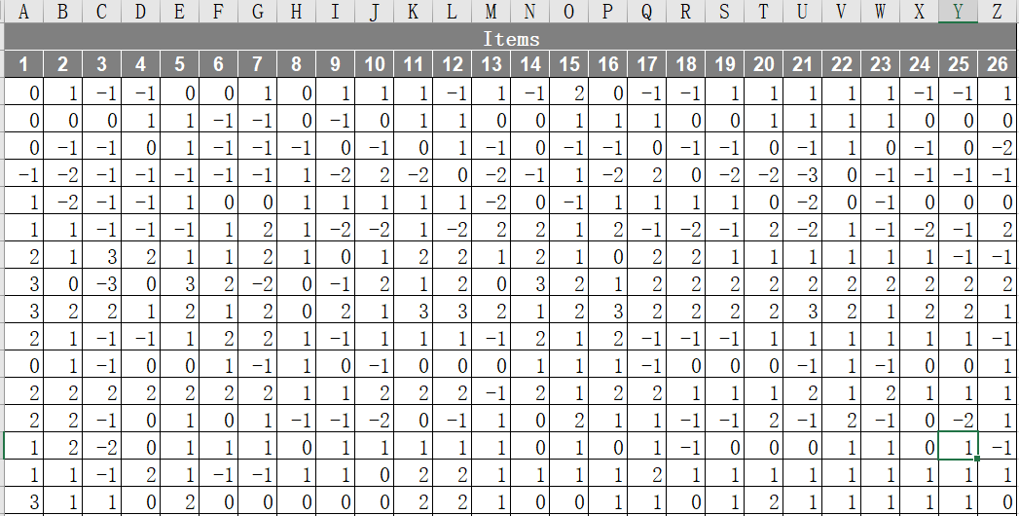
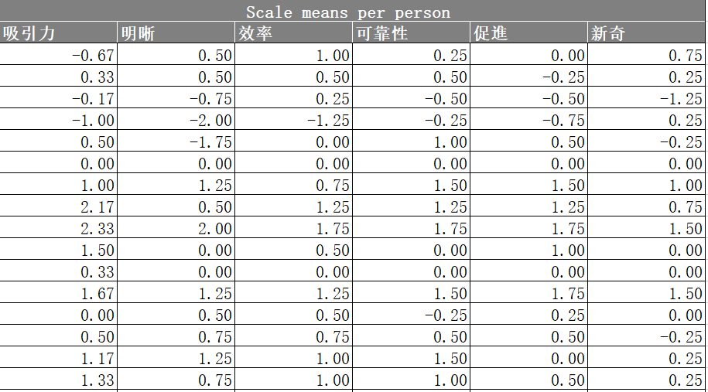
1.DT
The values have been transformed into one standard

Slide 4
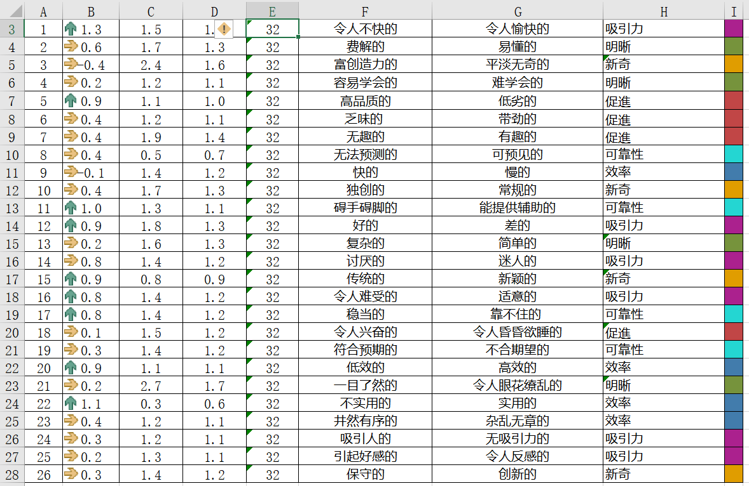
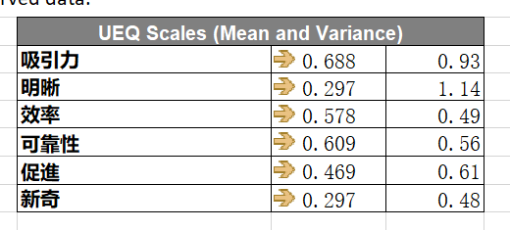
2.Result
The mean value of per item

Slide 5
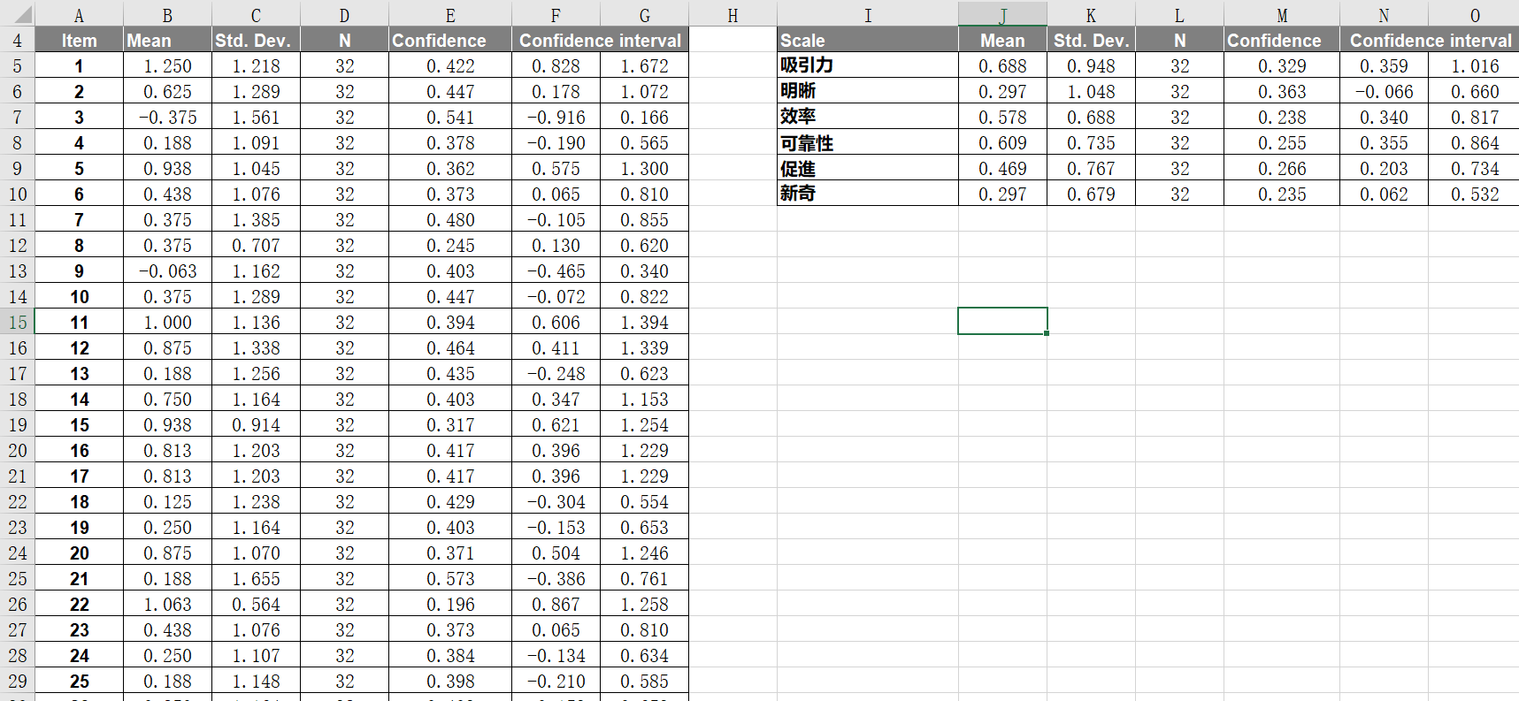
3.Confidence interval
The more consistent their opinion is the smaller is the confidence interval.

Slide 6
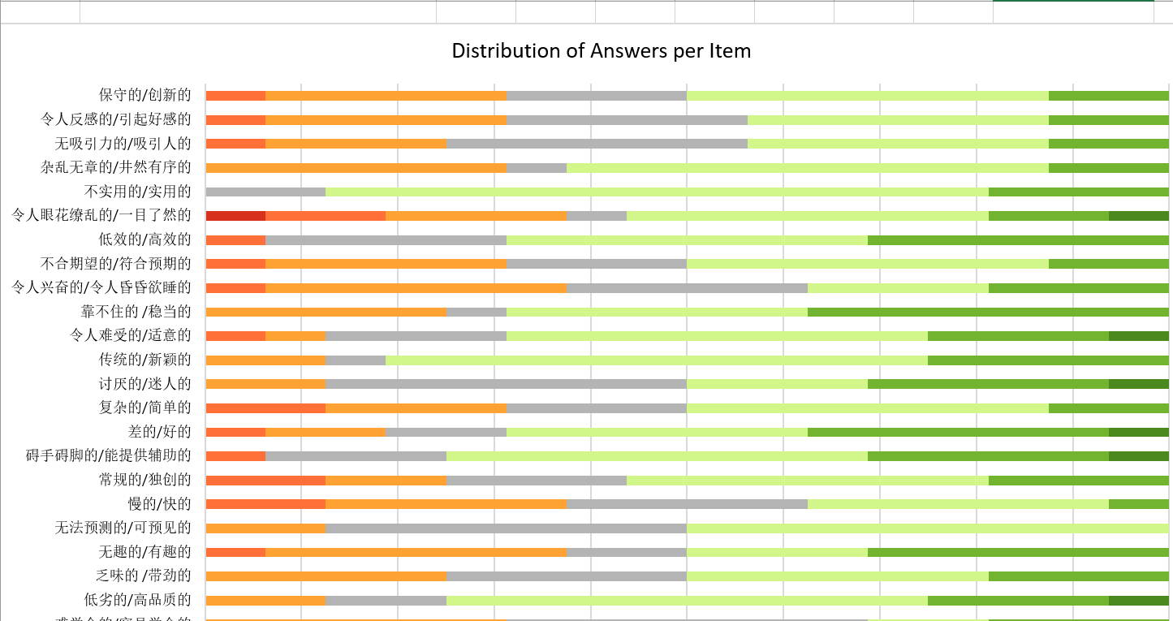
4.Answer distributions

Slide 7
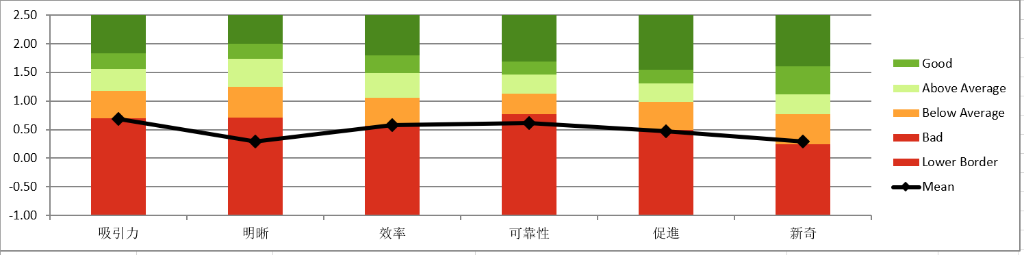
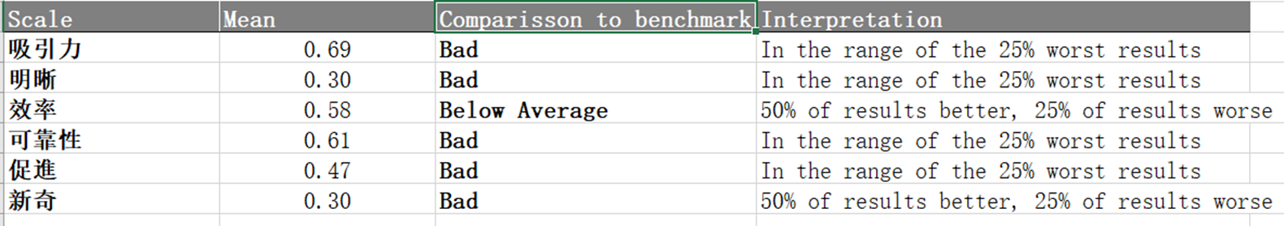
5.Benchmark
Comparison with the benchmark

Slide 8
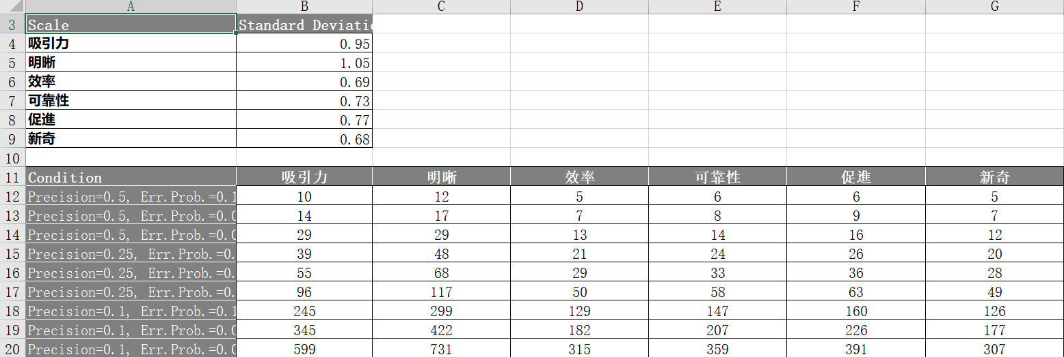
6.Sample size

Slide 9
Conclusion
The most students think that the platform named DaXia could support us a space to discuss , to get the content that the teacher had displayed in class ,to do the online homework and so on . But it is not very convenient for us to use the platform to learn. For instance , we can not get the information easily , can not get the response immediately ,can not use it if we are not under the inner net.

